Slide 1
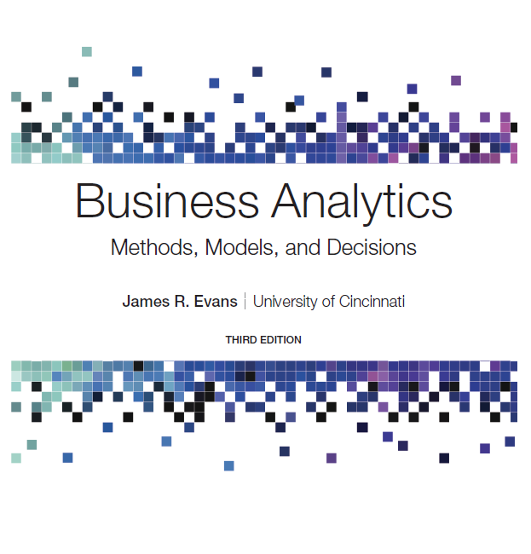
Business Analytics: Methods, Models, and Decisions
Third Edition
Forecasting Techniques
Slides in this presentation contain hyperlinks. JAWS users should be able to get a list of links by using INSERT+F7
Copyright © 2020, 2016, 2013 Pearson Education, Inc. All Rights Reserved
Notes:
If this PowerPoint presentation contains mathematical equations, you may need to check that your computer has the following installed:
1) MathType Plugin
2) Math Player (free versions available)
3) NVDA Reader (free versions available)

Slide 2
Forecasting Techniques
Managers require good forecasts of future events.
Business Analysts may choose from a wide range of forecasting techniques to support decision making.
Three major categories of forecasting approaches:
Qualitative and judgmental techniques
Statistical time-series models
Explanatory/causal models

Slide 3
Qualitative and Judgmental Forecasting
Qualitative and Judgmental techniques rely on experience and intuition.
They are necessary when historical data is not available or when predictions are needed far into the future.
The historical analogy approach obtains a forecast through comparative analysis with prior situations.
The Delphi method questions an anonymous panel of experts 2-3 times in order to reach a convergence of opinion on the forecasted variable.

Slide 4
Example 9.1: Predicting the Price of Oil
Early 1988 - oil price was about $22 a barrel
Mid-1988 - oil price dropped to $11 a barrel because of oversupply, high production in non-O P E C regions, and lower than normal demand
In the past, O P E C would raise the price of oil.
Historical analogy would forecast a higher price.
However, the price continued to drop even though O P P E C agreed to cut production.
Historical analogies cannot always account for current realities!

Slide 5
Statistical Forecasting Models
Time Series - a stream of historical data, such as weekly sales
T = number of periods,
Time series generally have components such as:
random behavior
trends (upward or downward)
seasonal effects
cyclical effects
Stationary time series have only random behavior.
A trend is a gradual upward or downward movement of a time series.

Slide 6
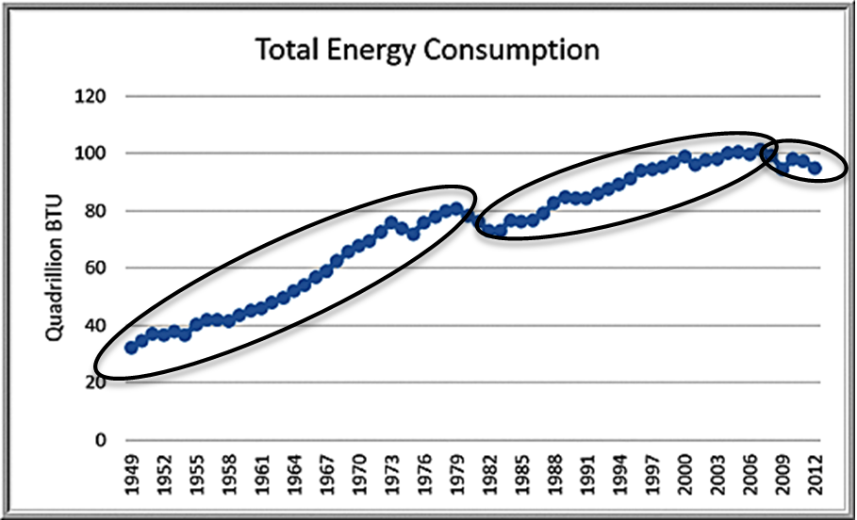
Example 9.4: Identifying Trends in a Time Series
Total Energy Production & Consumption
General upward trend with some short downward trends; the time series is composed of several different short trends.

Slide 7
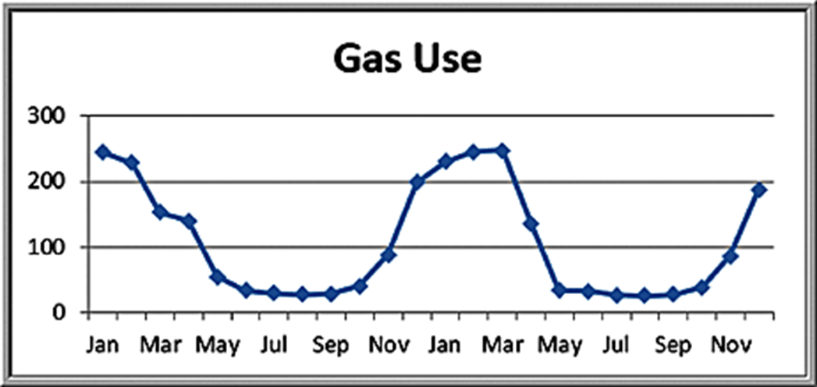
Seasonal Effects
A seasonal effect is one that repeats at fixed intervals of time, typically a year, month, week, or day.

Slide 8
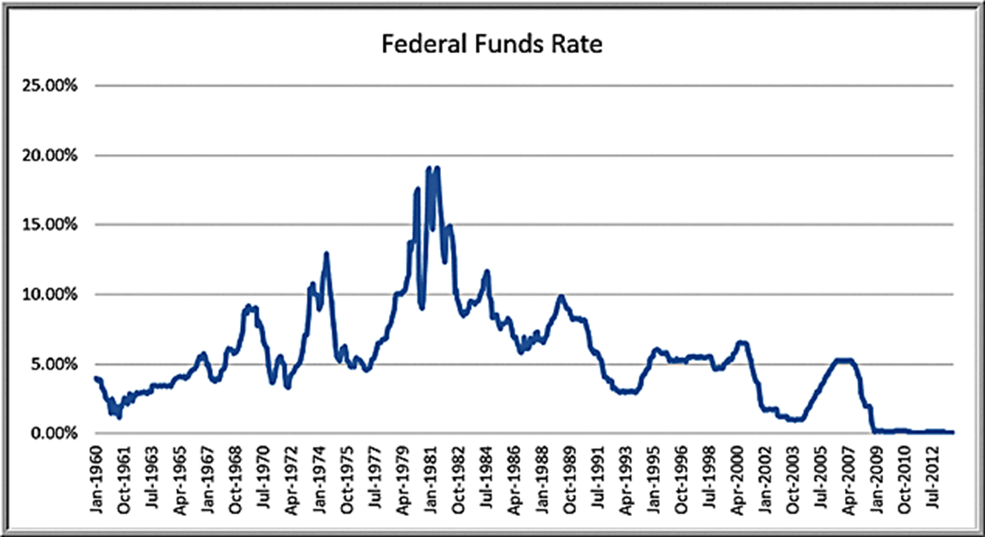
Cyclical Effects
Cyclical effects describe ups and downs over a much longer time frame, such as several years.

Slide 9
Forecasting Models for Stationary Time Series
Moving average model
Exponential smoothing model
These are useful over short time periods when trend, seasonal, or cyclical effects are not significant.

Slide 10
Moving Average Models
The simple moving average method is a smoothing method based on the idea of averaging random fluctuations in the time series to identify the underlying direction in which the time series is changing.
The simple moving average forecast for the next period is computed as the average of the most recent k observations.
Larger values of k result in smoother forecast models since extreme values have less impact.

Slide 11
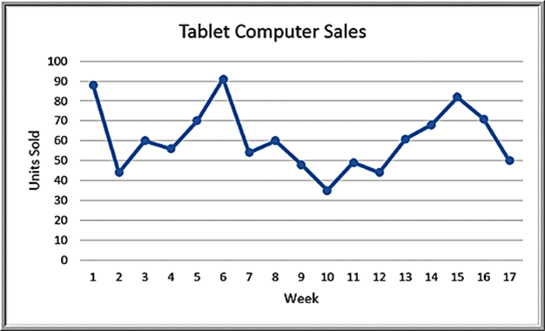
Example 9.5: Moving Average Forecasting
The Tablet Computer Sales file contains the number of units sold over the past 17 weeks.
Three-period moving average forecast for week 18:

Slide 12
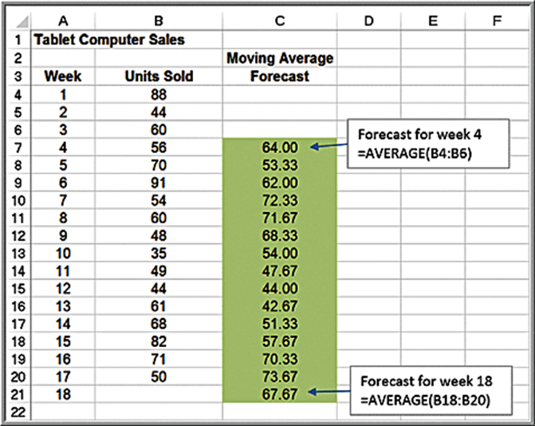
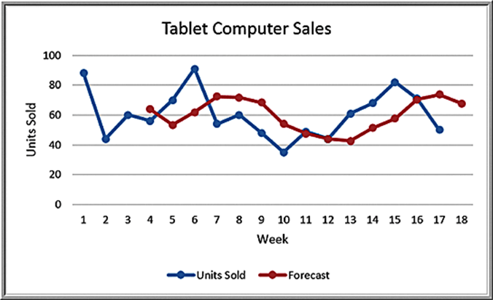
Spreadsheet Implementation of Moving Average Forecasting

Slide 13
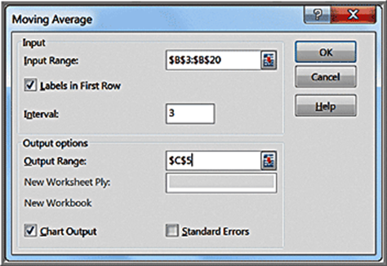
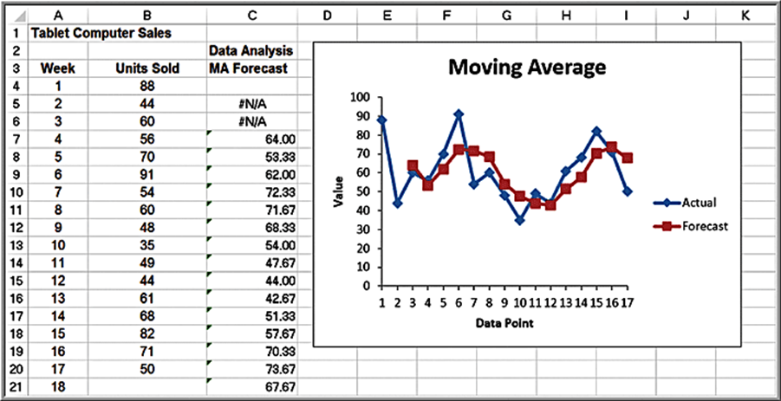
Example 9.6: Using Excel’s Moving Average Tool
Data Analysis options
We do not recommend using the chart or error options because the forecasts generated by this tool are not properly aligned with the data.

Slide 14
Error Metrics and Forecast Accuarcy
Mean absolute deviation (M A D)
Mean square error (M S E)
Root mean square error (R M S E)
Mean absolute percentage error (M A P E)

Slide 15
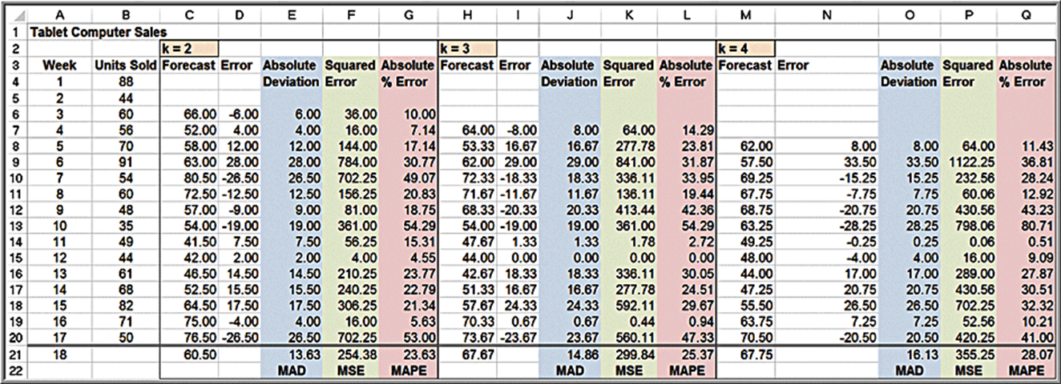
Example 9.7: Using Error Metrics to Compare Moving Average Forecasts
Tablet Computer Sales data
2-, 3-, and 4-period moving average models
2-period model has lowest error metric values.

Slide 16
Exponential Smoothing Models
Simple exponential smoothing model:
where
is the forecast for time period
is the
forecast for period t,
is the observed value in period t,
and α is a constant between 0 and 1 called the smoothing constant.
To begin, set
equal to the actual observation in
period 1,

Slide 17
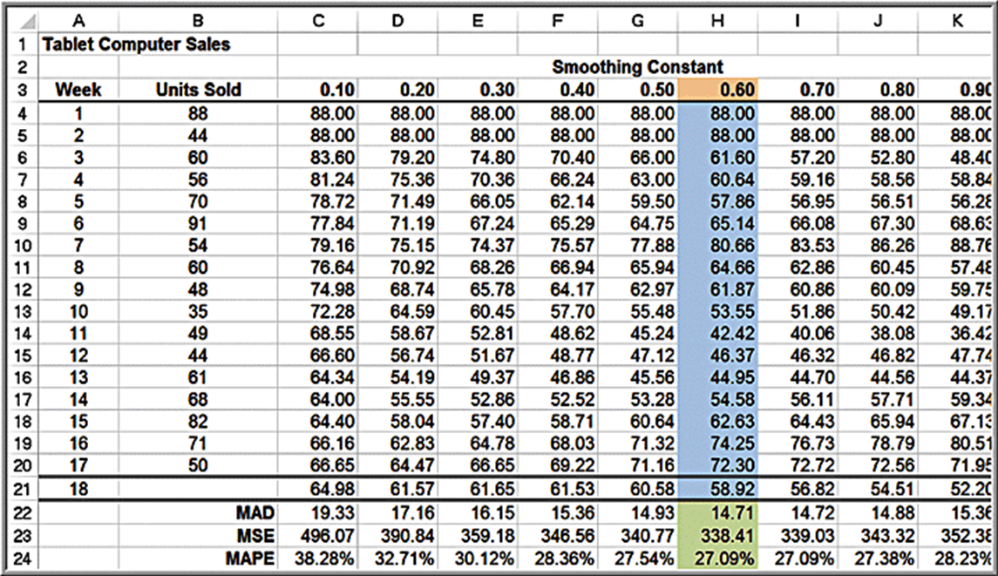
Example 9.8: Using Exponential Smoothing to Forecast Tablet Computer Sales
Forecast for week 3 when

Slide 18

Example 9.9: Finding the Best Exponential Smoothing Model for Tablet Computer Sales
The forecast using α =0.6 provides the lowest error metrics.

Slide 19
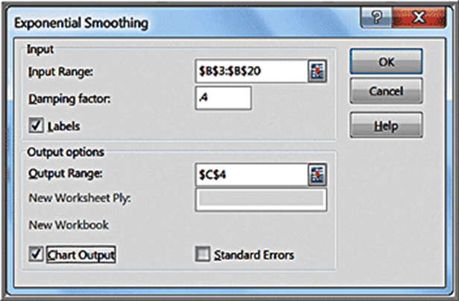
Example 9.10: Using Excel’s Exponential Smoothing Tool (1 of 2)
Select Data Analysis from the Analysis group and then choose Exponential Smoothing.
Note that Damping factor = 1−α
The first cell of the Output Range should be adjacent to the first data point.

Slide 20
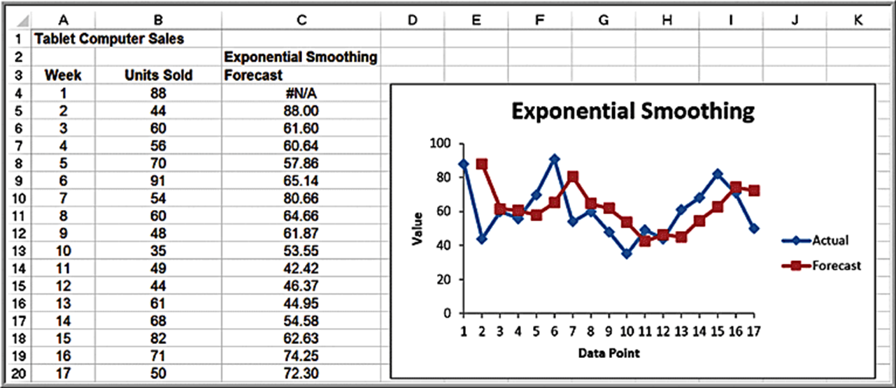
Example 9.10: Using Excel’s Exponential Smoothing Tool (2 of 2)
Exponential Smoothing tool results

Slide 21
Forecasting Models for Time Series with a Linear Trend
Double moving average and double exponential smoothing
Based on the linear trend equation
The forecast for k periods into the future is a function of
the level
and the trend
The models differ in their computations of

Slide 22
Double Exponential Smoothing
Estimates of the parameters are obtained from the following equations:
Initial values are chosen for
Equation (9.8) must then be used to compute
for the entire time series to be able to generate forecasts into the future. The forecast for k periods beyond the last period (period T) is

Slide 23
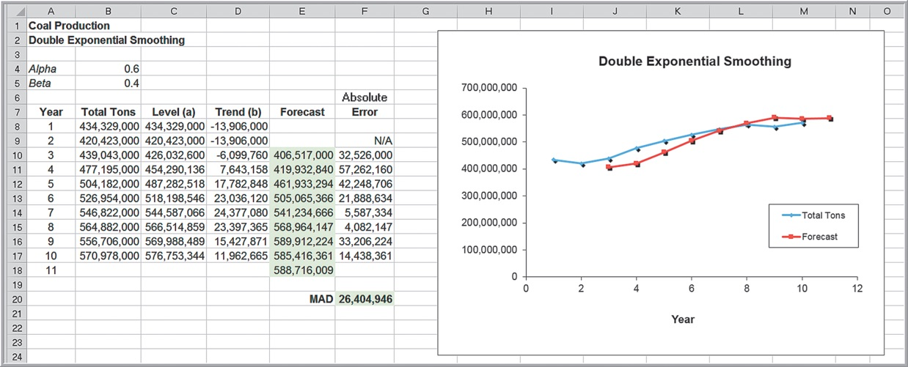
Example 9.11: Double Exponential Smoothing
First ten years of data in the Excel file Coal Production
Choose α = 0.6 and β = 0.4
See text for computational details.

Slide 24
Regression-Based Forecasting for Time Series with a Linear Trend
Simple linear regression can be applied to forecasting using time as the independent variable.

Slide 25
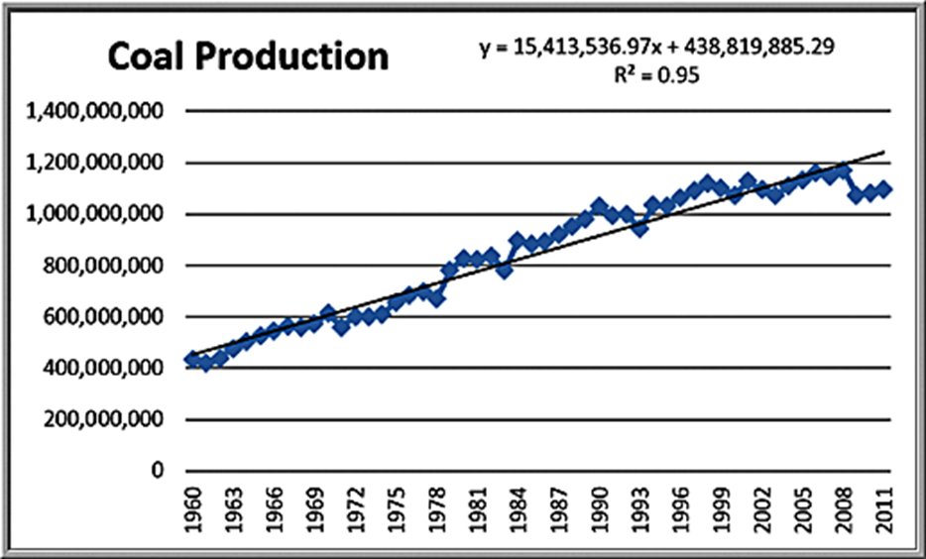
Example 9.12: Forecasting Using Trendlines
Coal Production data with a linear trendline
Note that the linear model does not adequately predict the recent drop in production after 2008.

Slide 26
Forecasting Time Series with Seasonality
When time series exhibit seasonality, different techniques provide better forecasts than the ones we have described:
Multiple regression models with categorical variables for the seasonal components
Holt-Winters models, similar to exponential smoothing models in that smoothing constants are used to smooth out variations in the level and seasonal patterns over time.

Slide 27

Example 9.13: Regression-Based Forecasting for Natural Gas Usage (1 of 3)
Gas & Electric Excel file
Use a seasonal categorical variable with k = 12 levels.
Construct the regression model using k − 1 dummy variables, with January being the reference month.

Slide 28
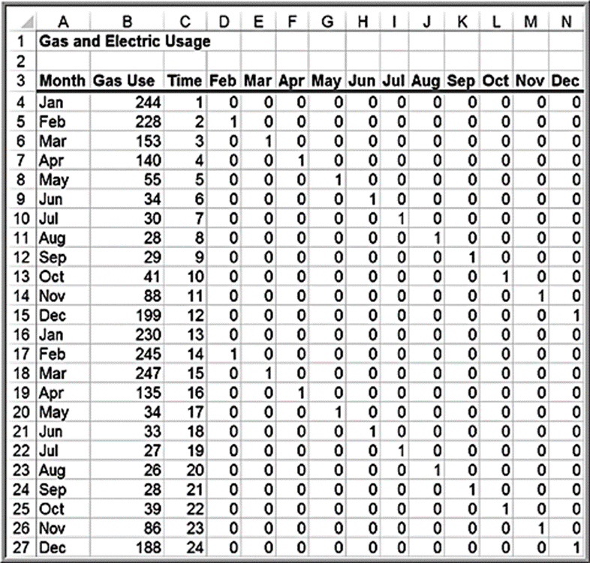
Example 9.13: Regression-Based Forecasting for Natural Gas Usage (2 of 3)
Data matrix

Slide 29
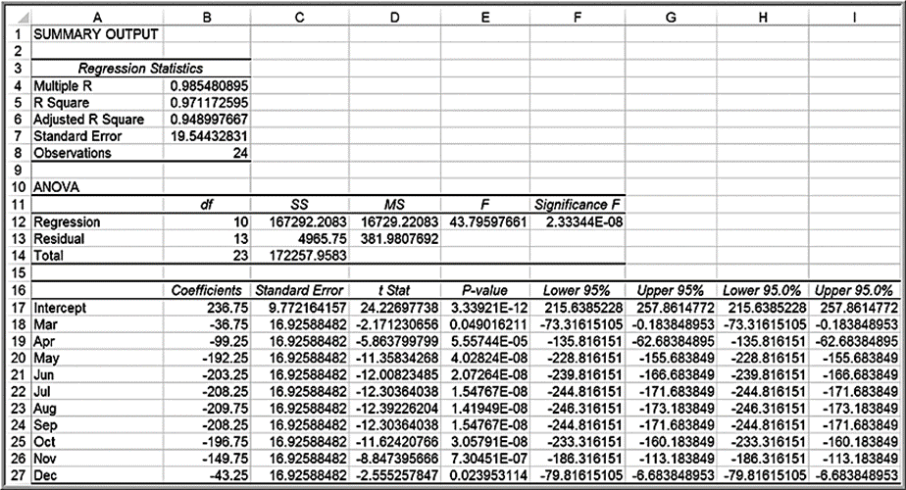
Example 9.13: Regression-Based Forecasting for Natural Gas Usage (3 of 3)
Final regression results (time and February were insignificant)

